Slide 1


We’re In This Together
Women’s Health Event
March 25, 2026

Slide 2
Not Your Mama’s Menopause
Notes:
Provider Skit

Slide 3
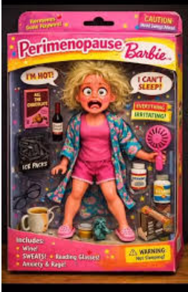
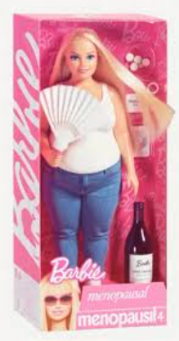
Menopausal Barbie
Yes, my friends… there is a
Barbie for that.
We are not alone!

Slide 4
Michelle Hauser, PA-C
Urology/ Menopause Health
YOU DESERVE TO THRIVE,
NOT JUST SURVIVE!!!!!

Slide 5
THANK YOU TO OUR MOTHERS, GRANDMOTHERS FOR ENDURING MENOPAUSE SYMPTOMS WITHOUT BATTING AN EYE!
THANK YOU TO THE Gen X and Y and MILLENNIALS FOR ASKING THE TOUGH QUESTIONS AND DEMANDING ANSWERS!

Slide 6
Menopause
A normal, natural event, defined by the final menstrual period (FMP) and confirmed after 1 year of no menstrual bleeding.
Represents the permanent cessation of menses resulting from loss of ovarian follicular function, usually because of aging.
Normally occurs between the ages of 40 and 58 years.

Slide 7
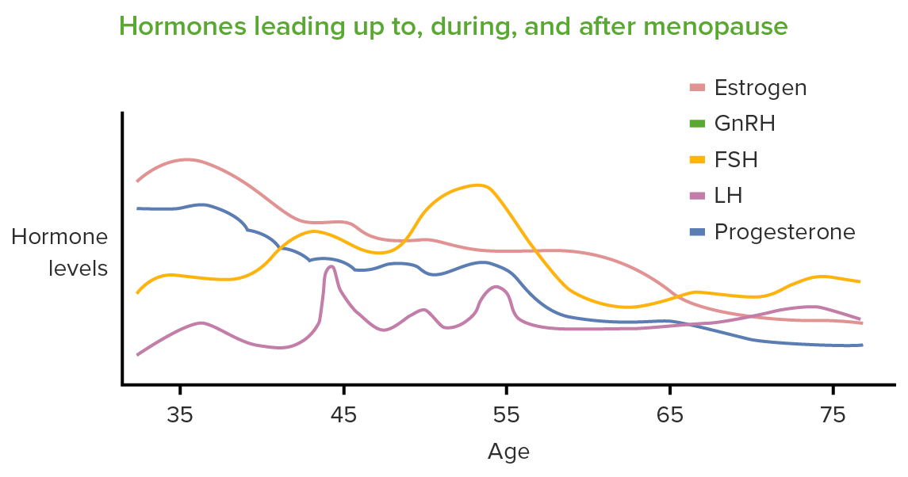
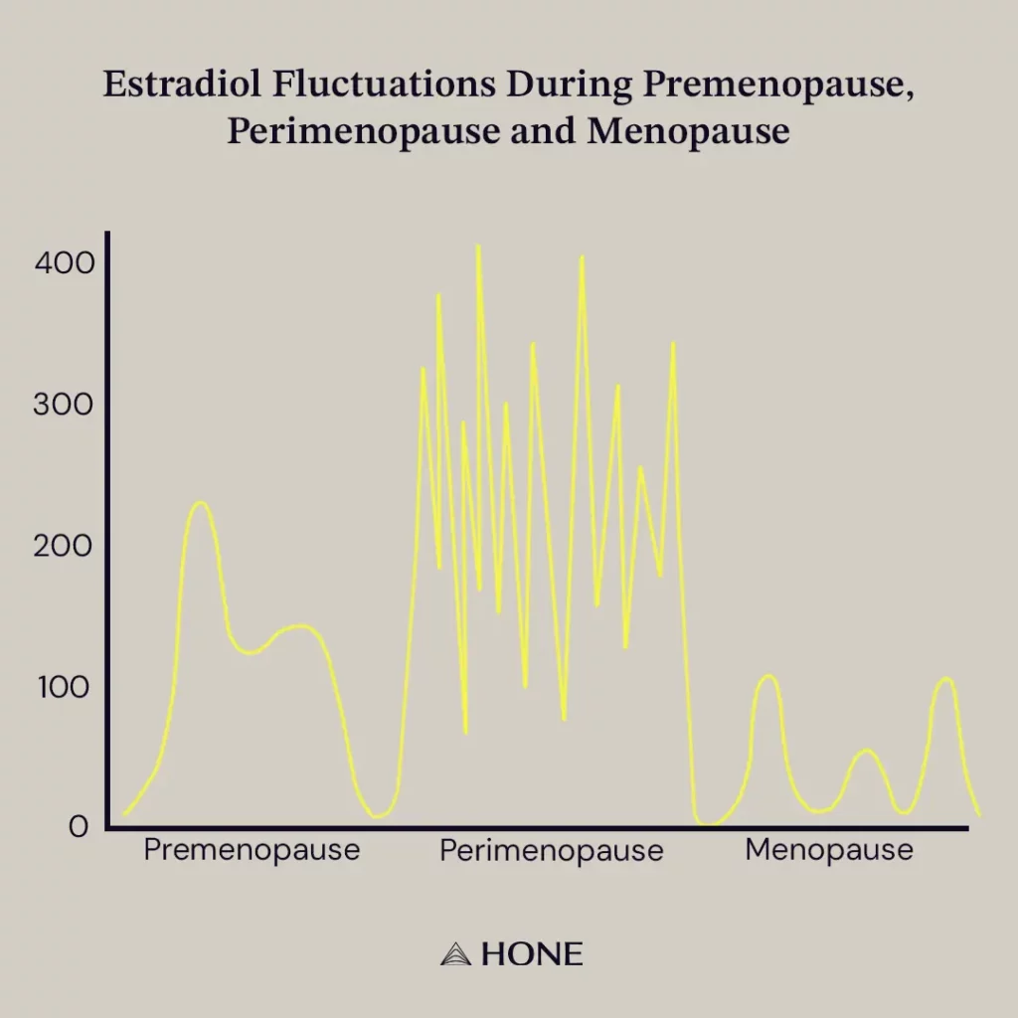

Slide 8
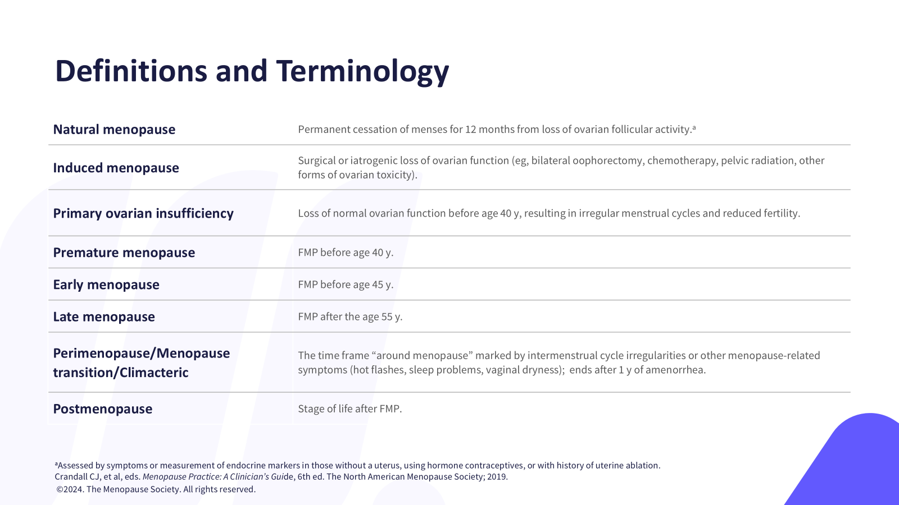

Slide 9
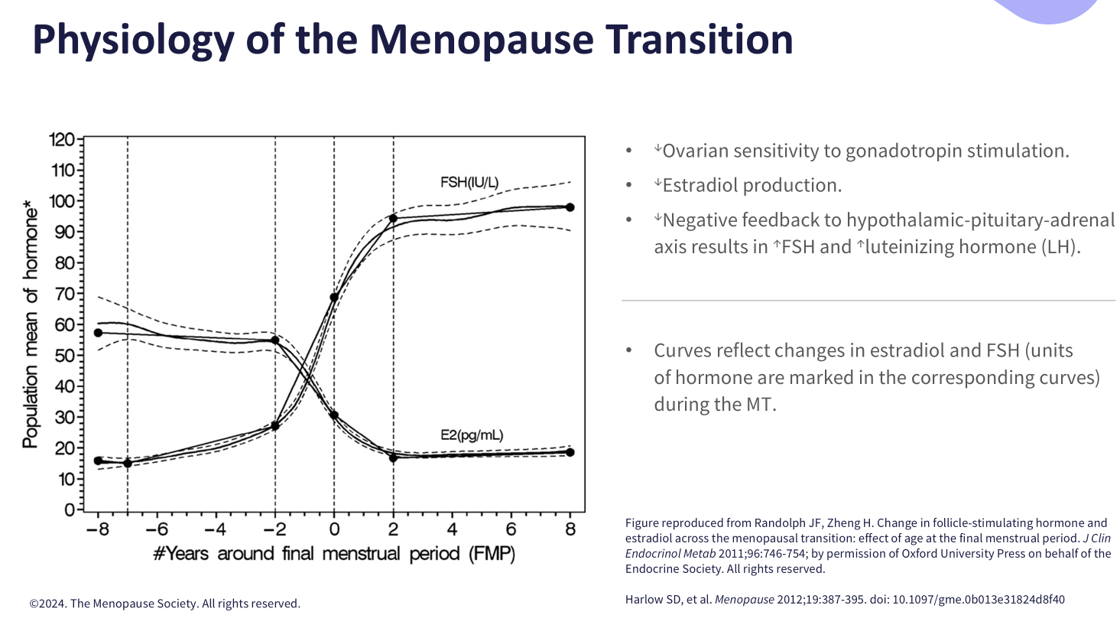

Slide 10
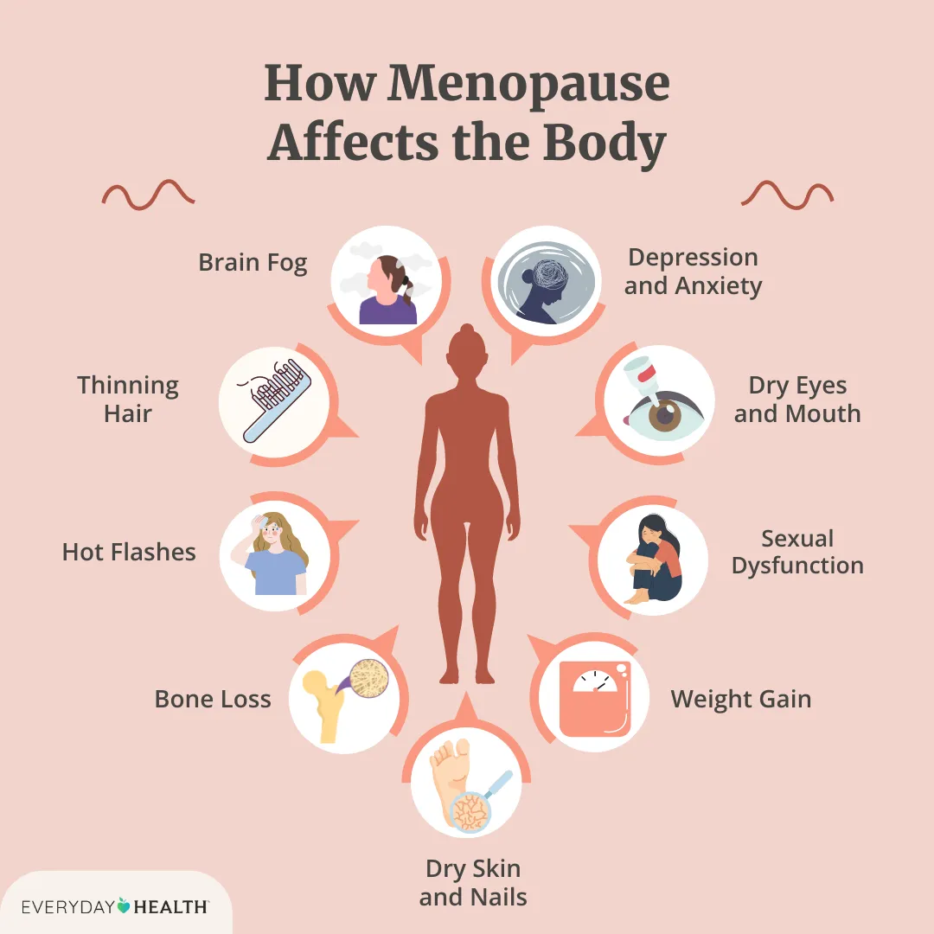
Notes:
Itchy ears

Slide 11
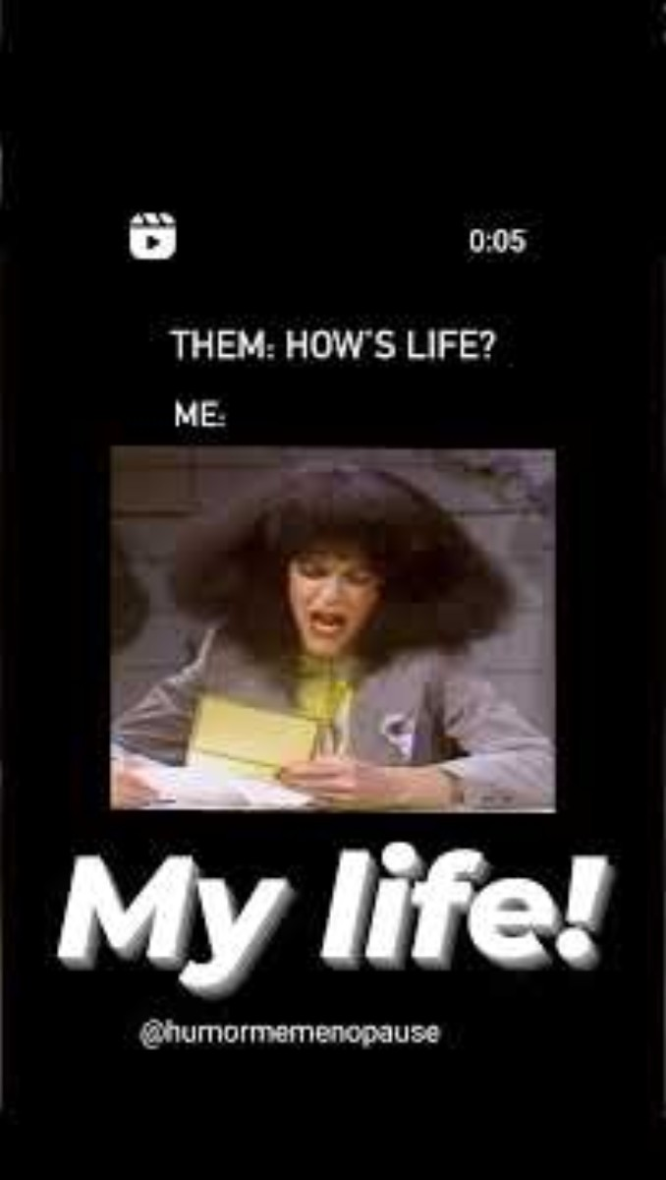

Slide 12
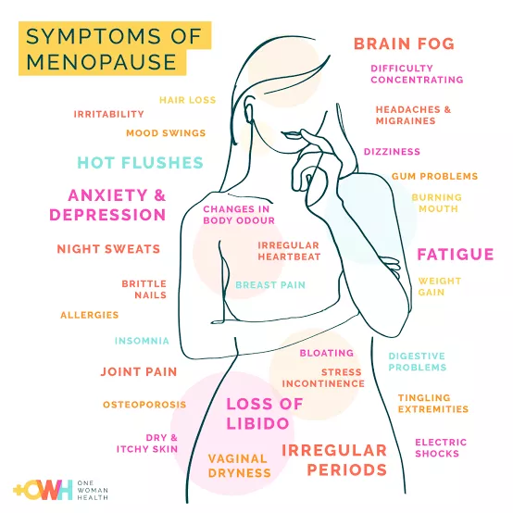

Slide 13

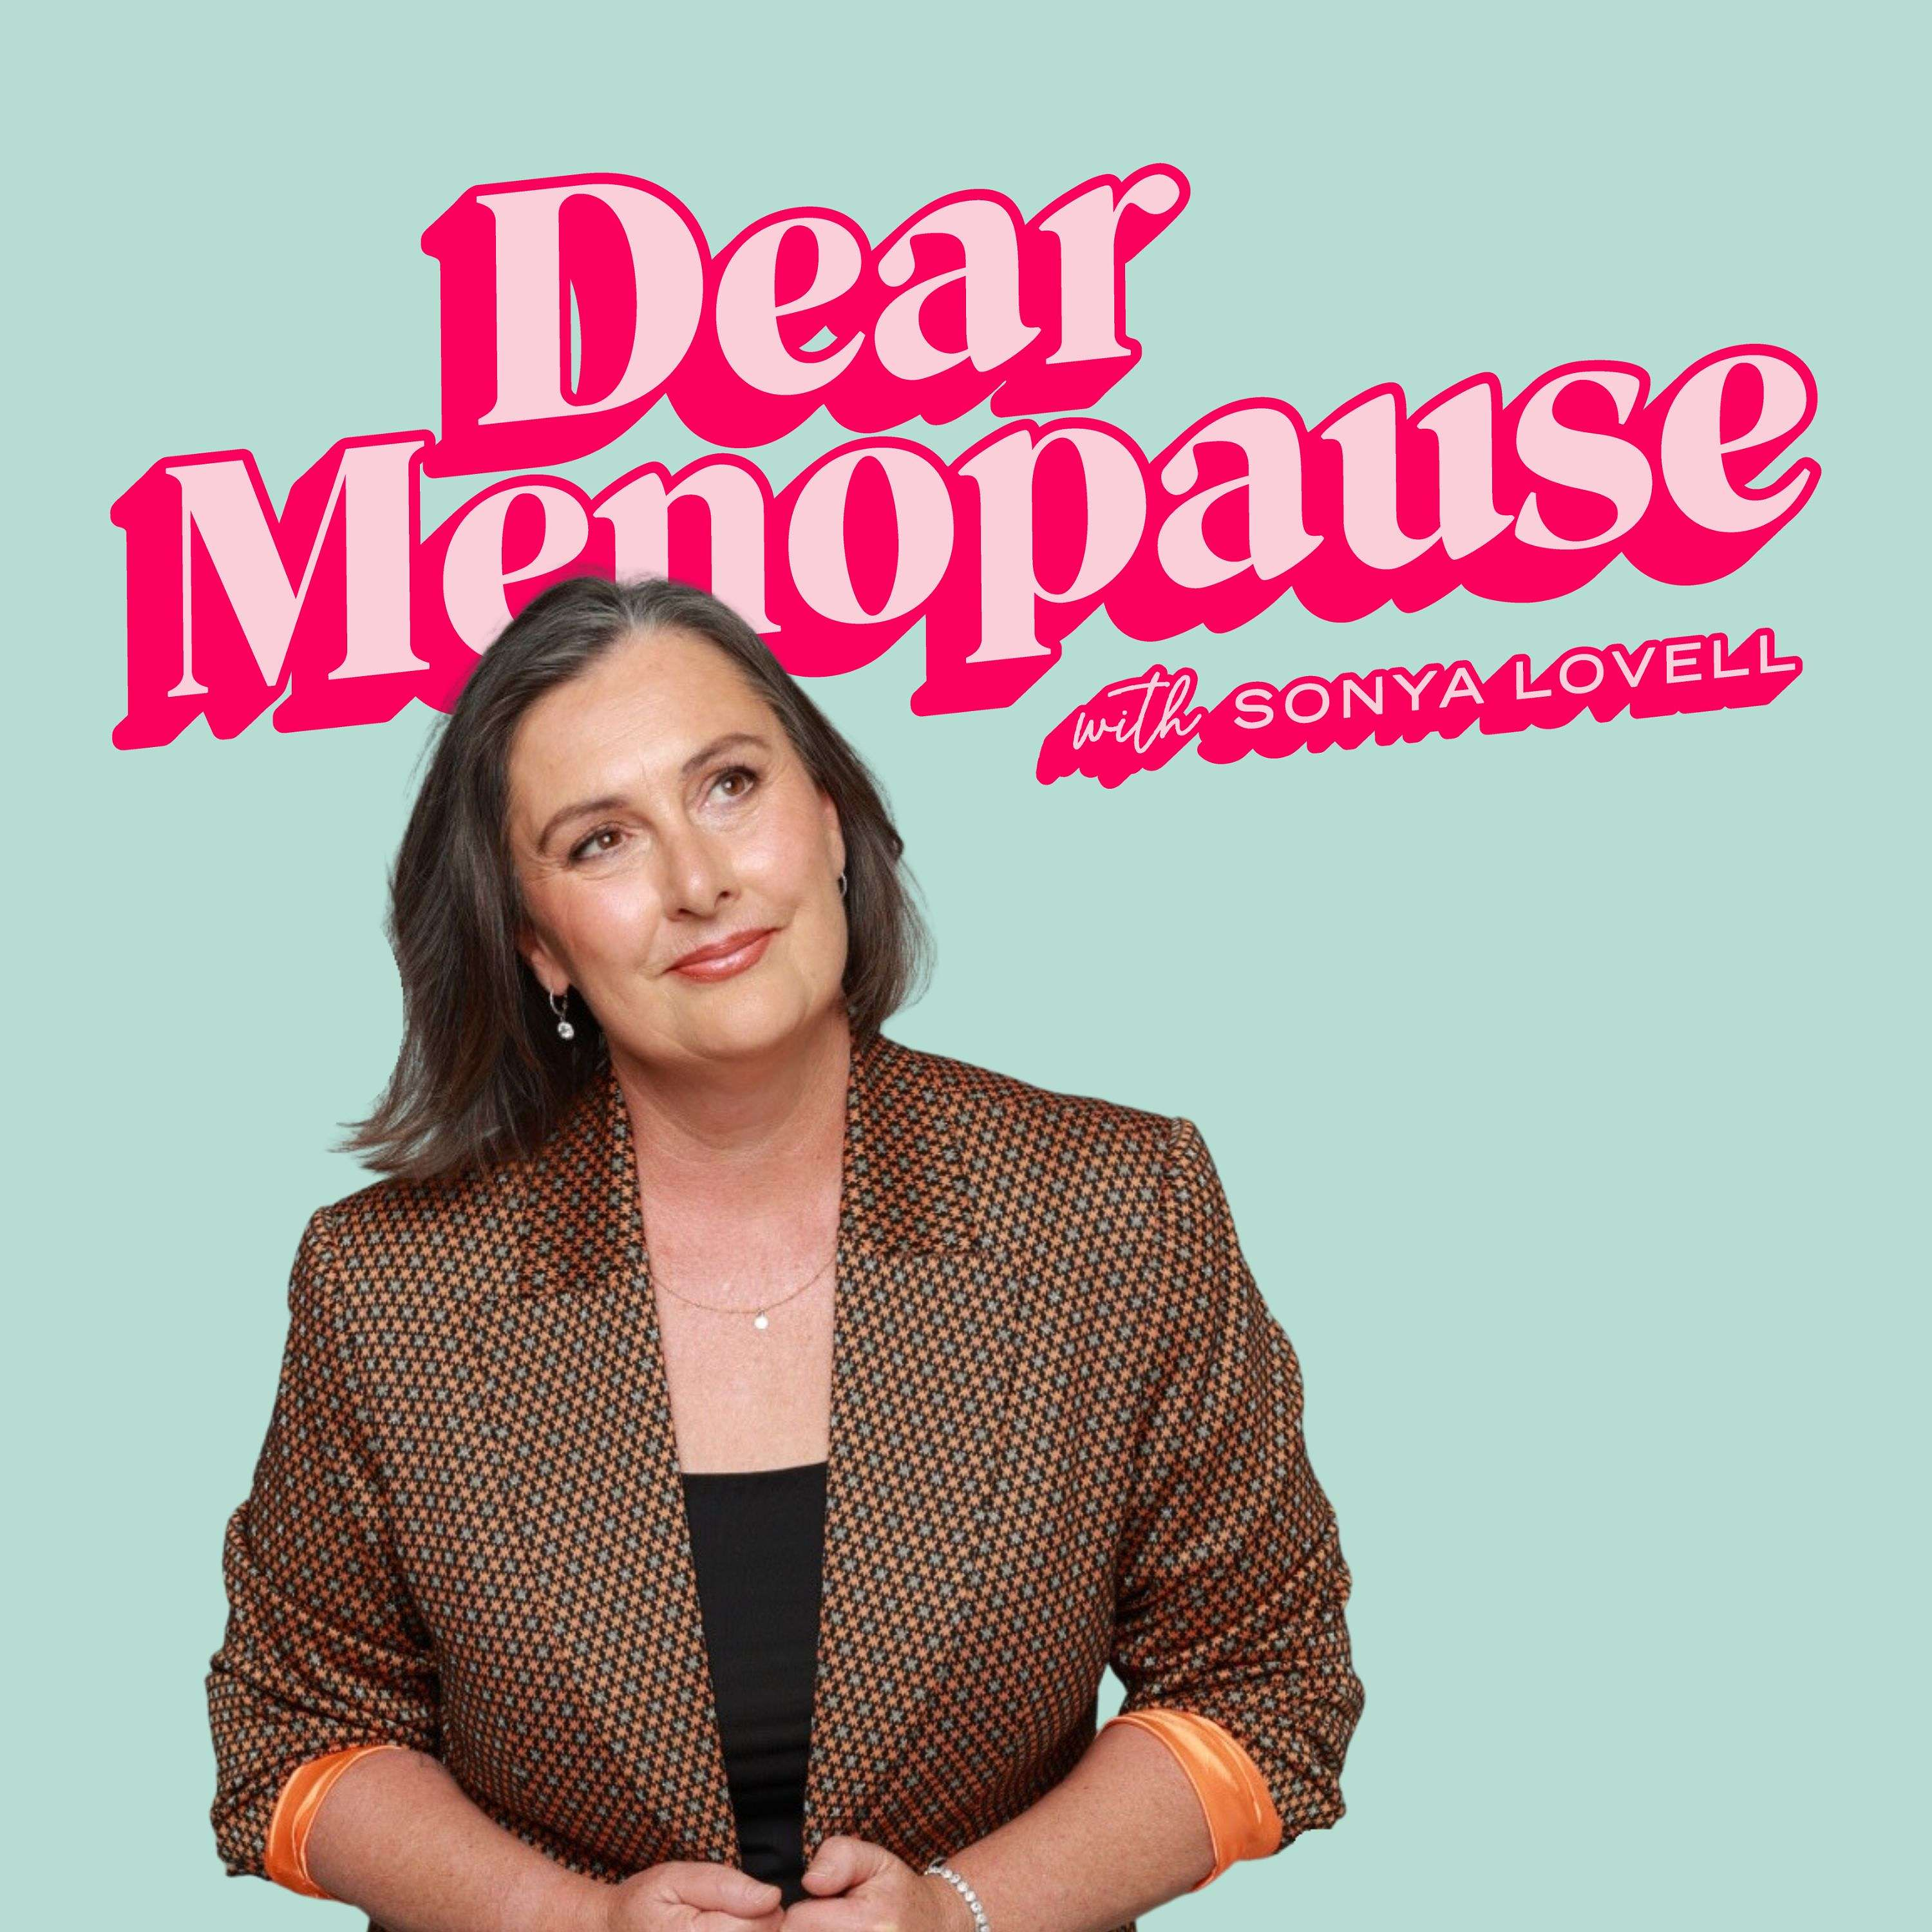
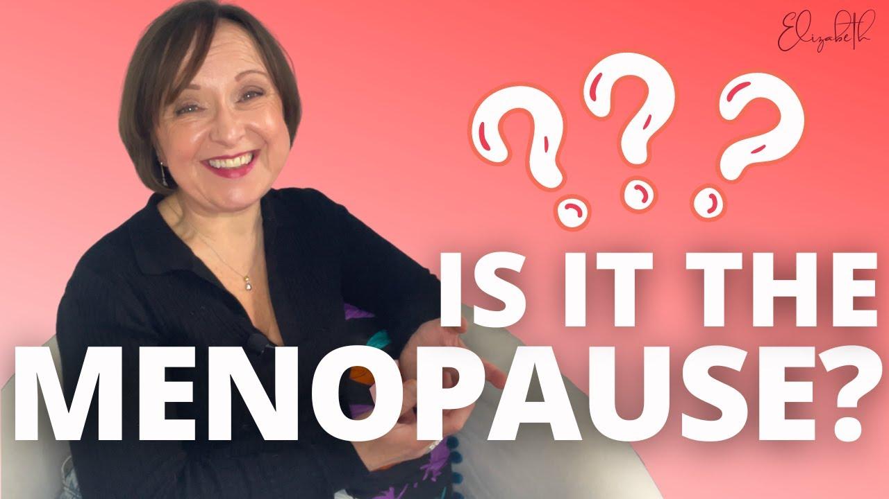

Slide 14
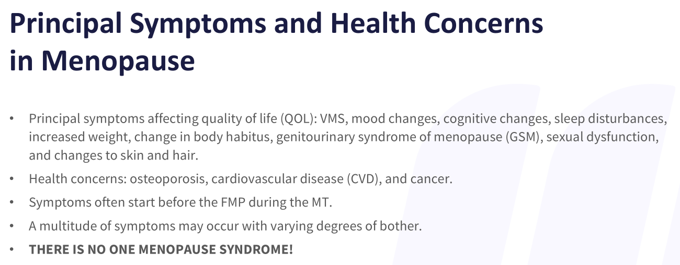

Slide 15
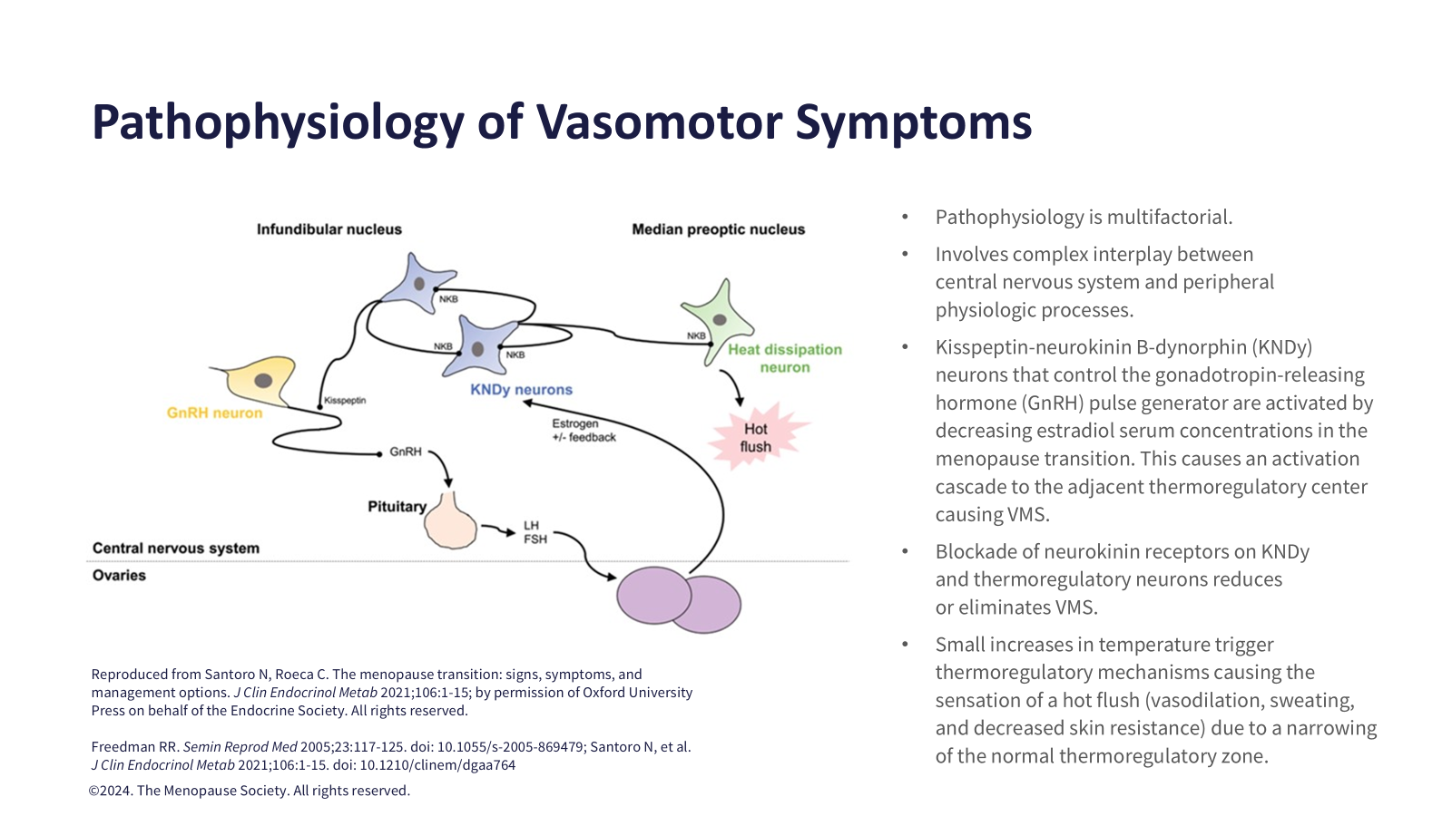
Notes:
VEOHZAH AND LYNKUET

Slide 16

Notes:
ONCE THOUGT BENIGN, NO MORE!!! ASSOCIATED WITH EARLY COGNITIVE DECLINE AND EARLY HEART DISEASE.

Slide 17
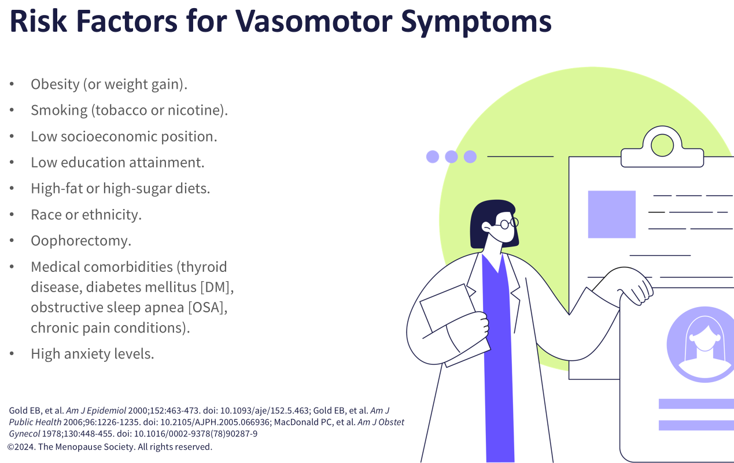
Notes:
R/O THYROID LAST 10 YEARS LEG THEREMOMETER,

Slide 18
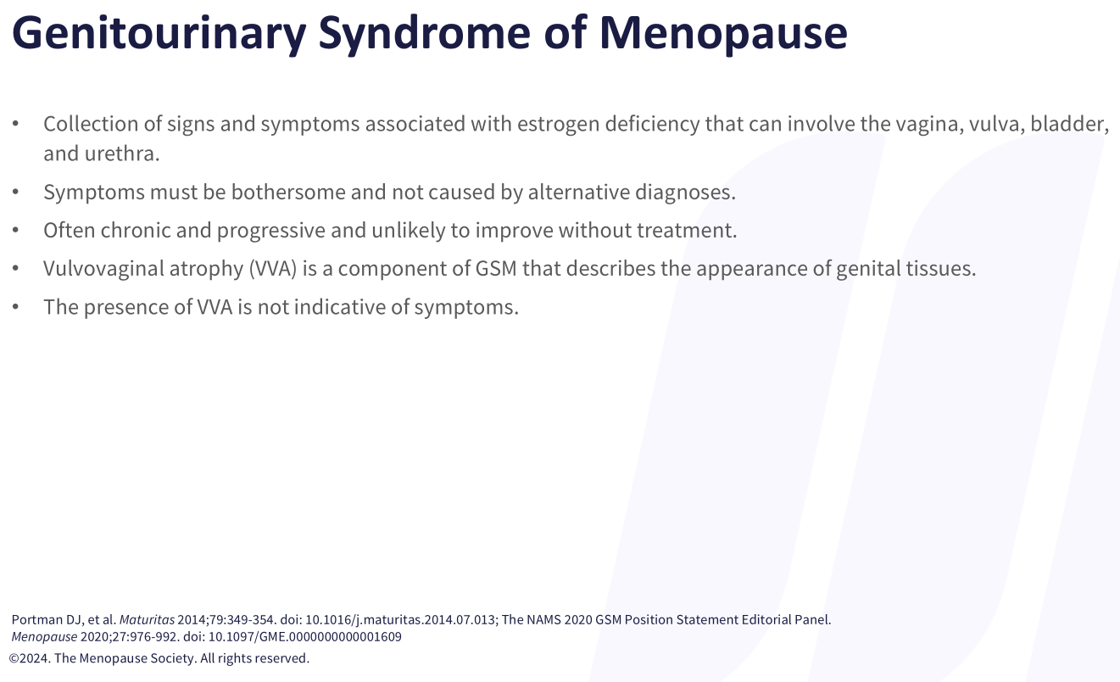

Slide 19
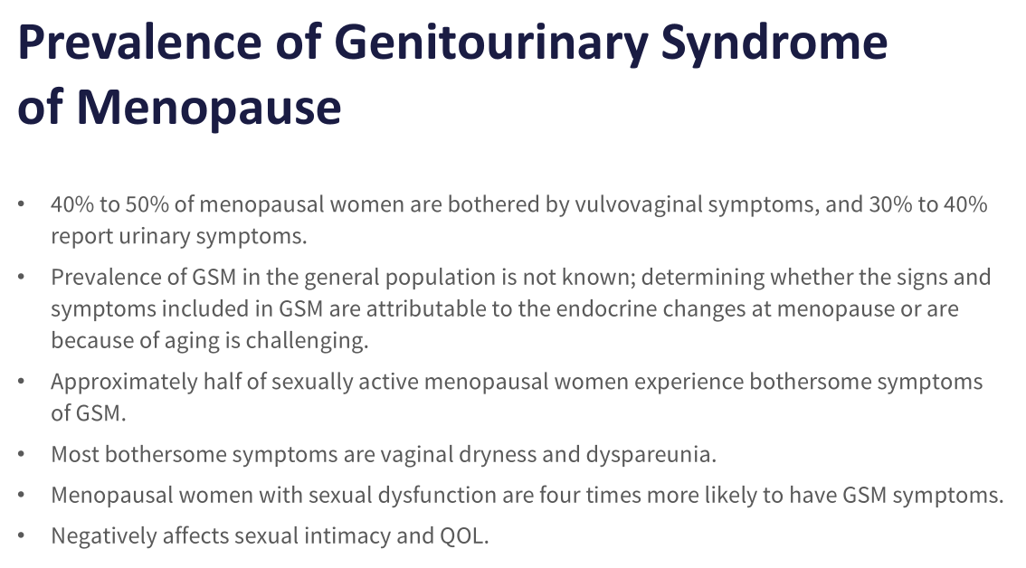
Notes:
BLACK BOX WARNING FOR TOPICAL VAGINAL ESTROGEN 50 BILLION SAVINGS FOR NH PATIENTS DUE TO RECURRENT UTI AND UROSEPSIS

Slide 20
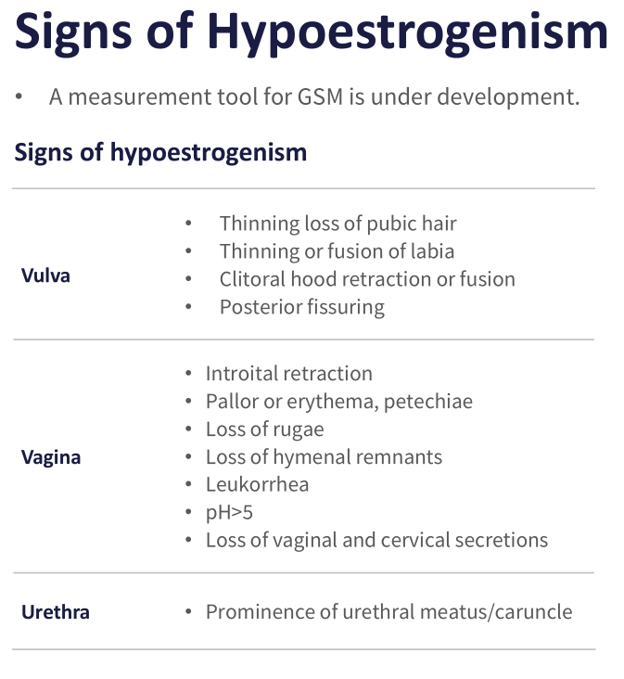

Slide 21
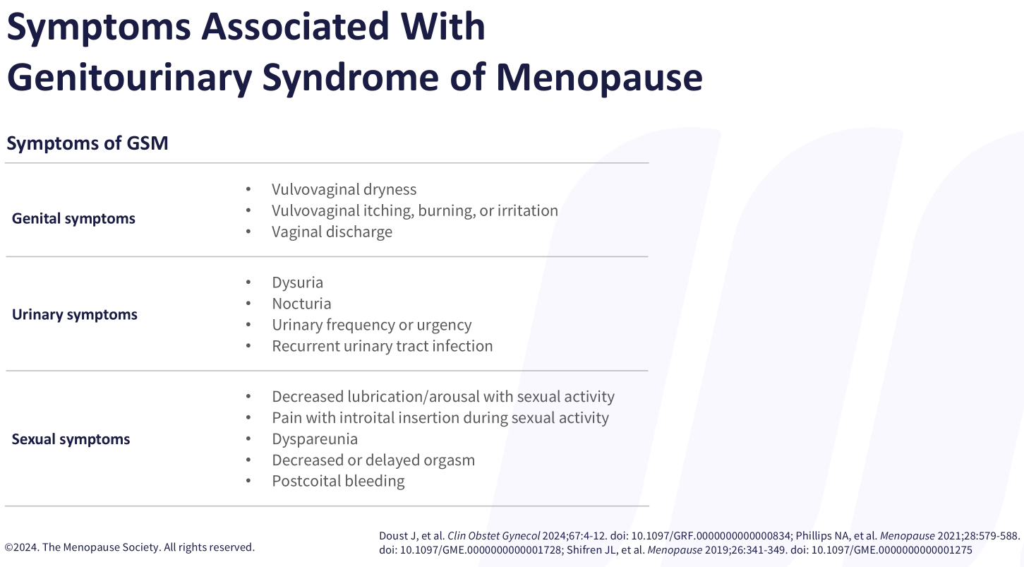
Notes:
CAN BE MANY OTHER CAUSES, MUST HAVE EXAM TO EVALUATE FOR SKIN CHANGES THAT CAN CAUS LICHEN SCLEROSIS, PELVIC FLOOR PT

Slide 22
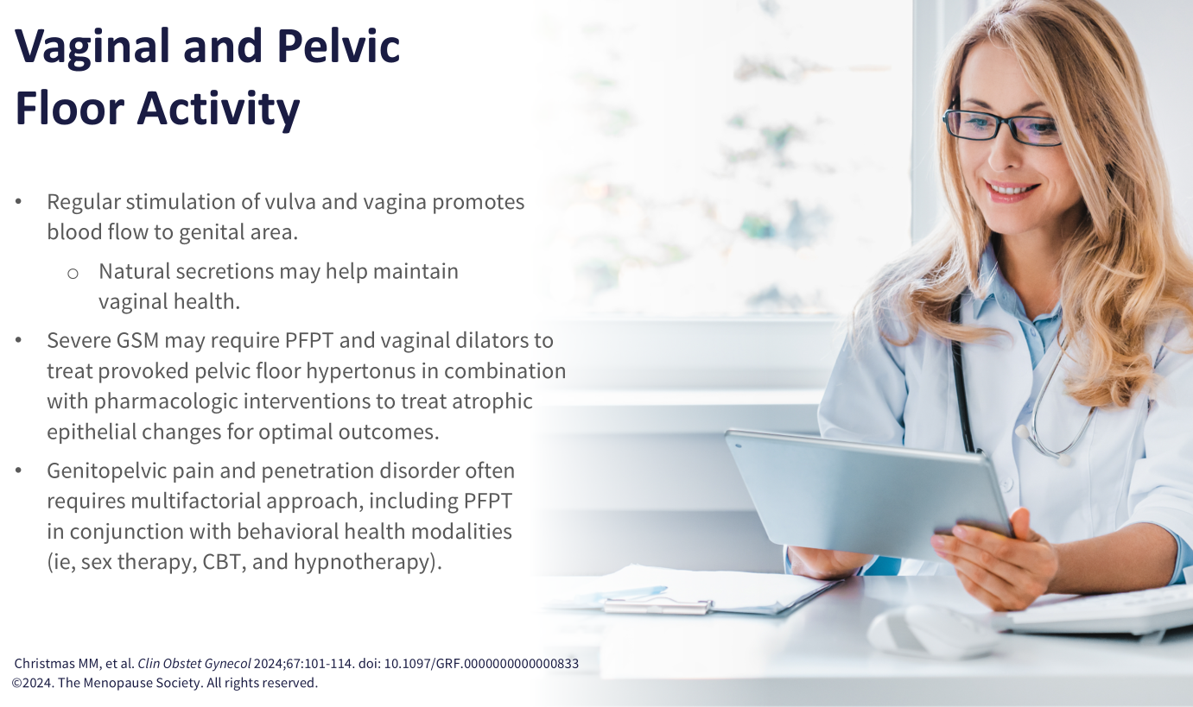
Notes:
pelvic floor dysfunction because of hypertonicity of the pelvic floor muscles.

Slide 23


Your Pelvic Floor Physical Therapy Team
NELLA BERNARDONI, PT
STEPHANIE CLEARY, PT

Slide 24
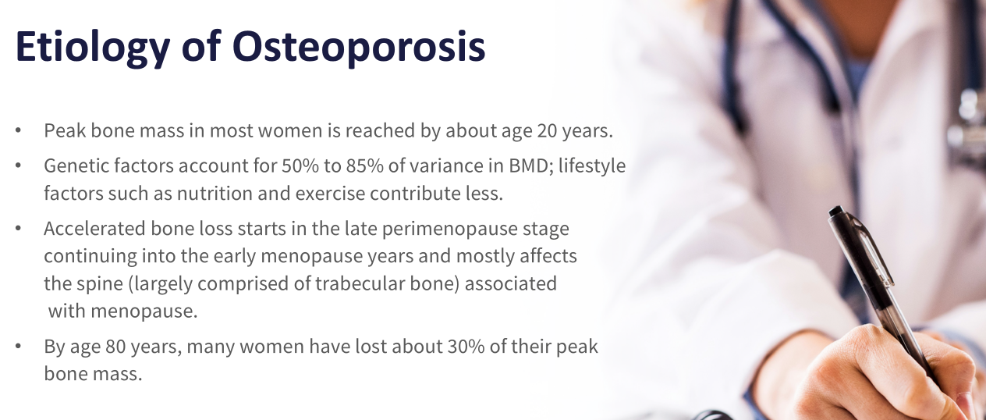

Slide 25
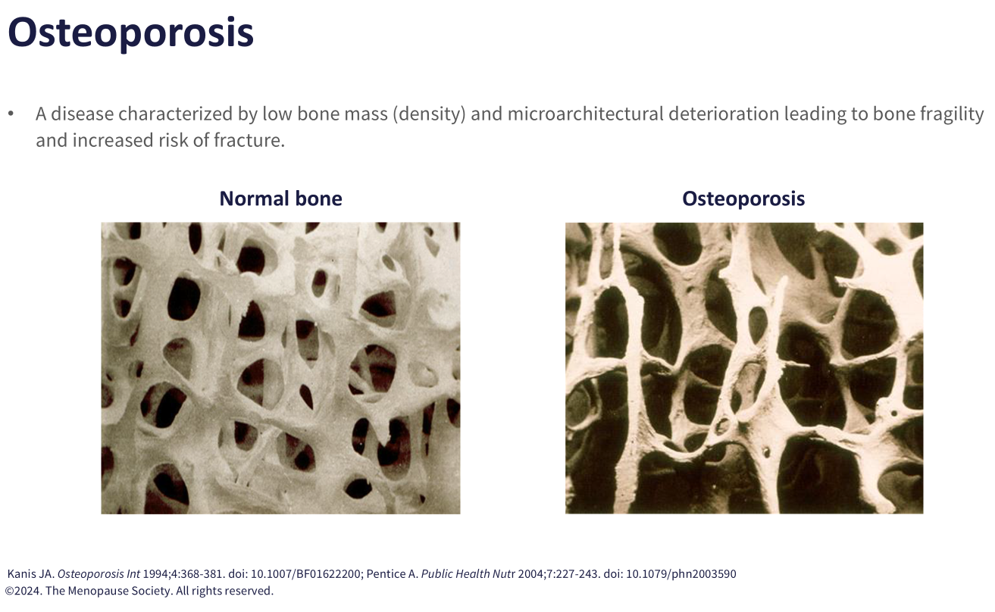

Slide 26
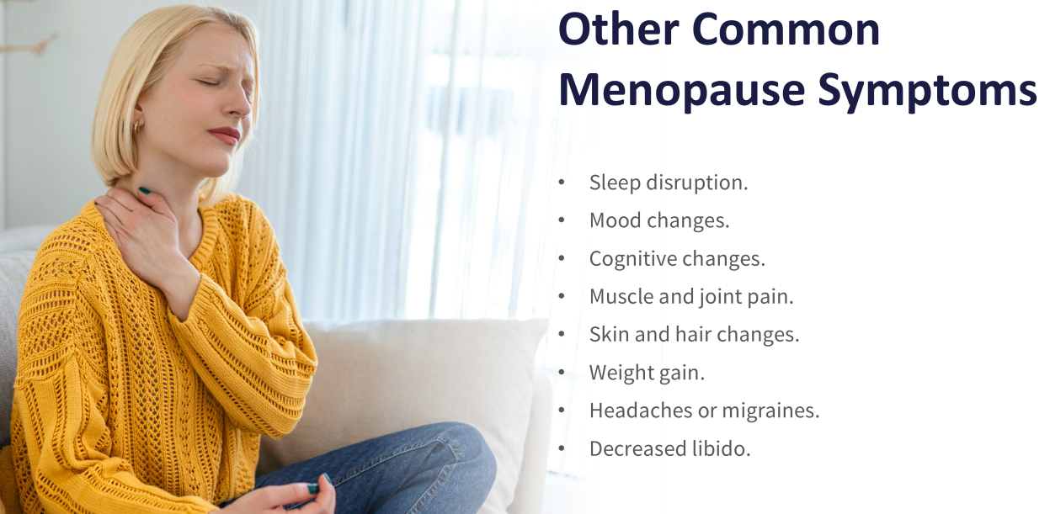
Notes:
AFFECTS REM AND DEEP SLEEP, FROZEN SHOULDER 50% POST MENOPAUSE HAVE osa, RESTLESS LEGS

Slide 27
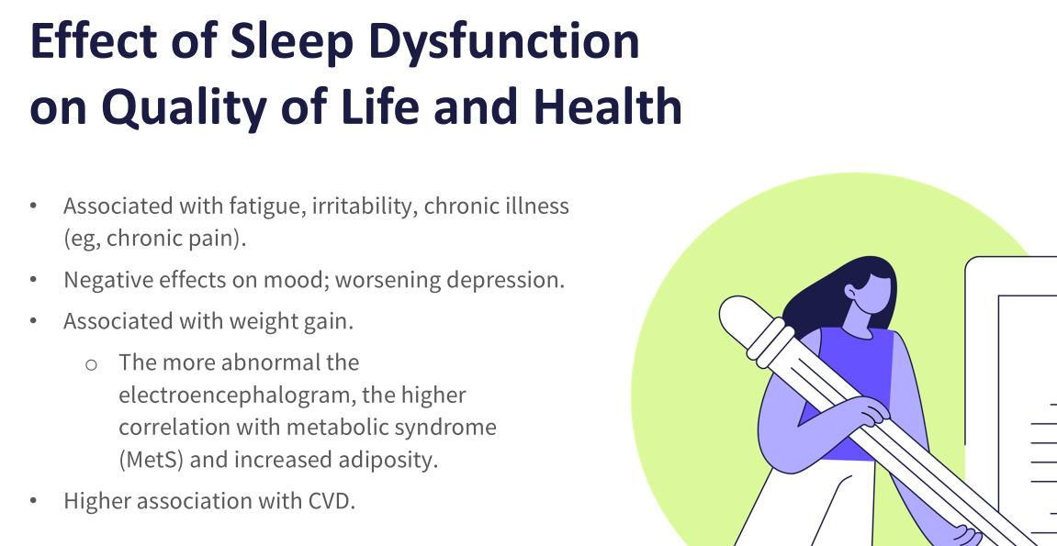

Slide 28
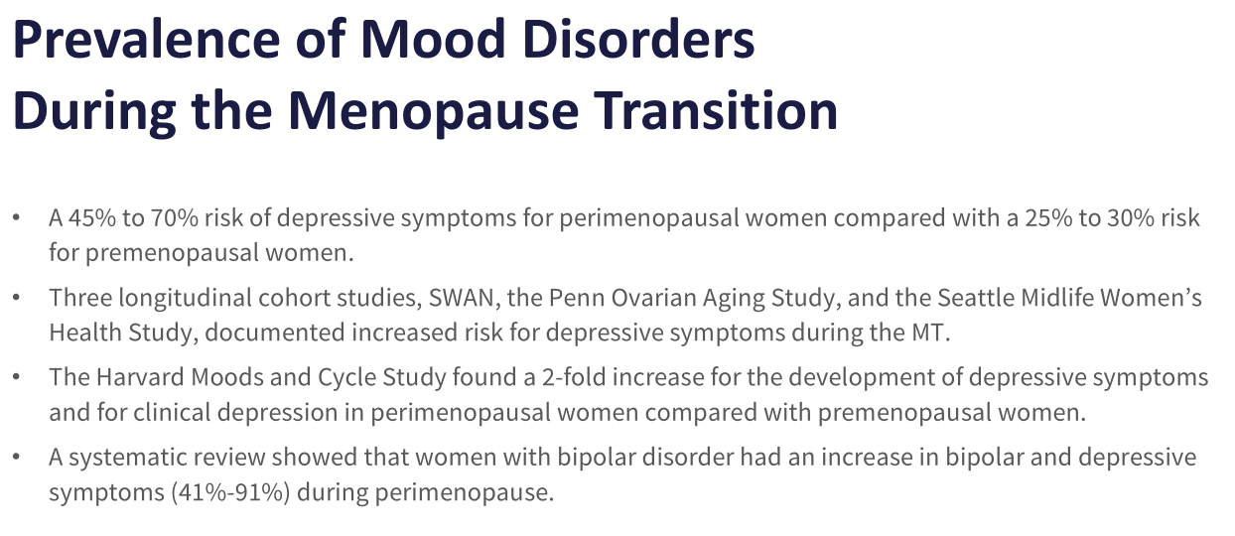

Slide 29
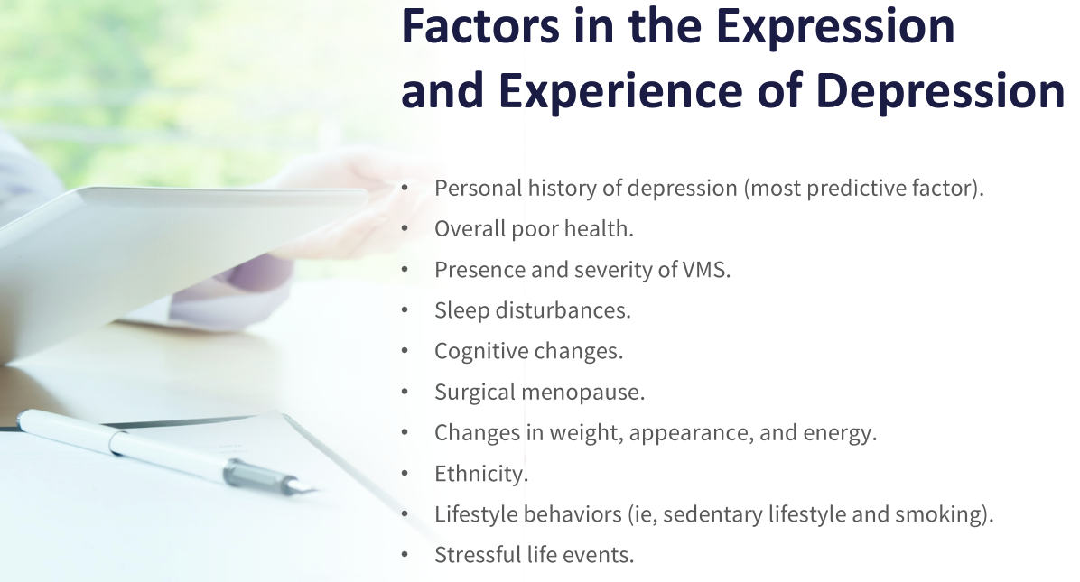
Notes:
S/;P HYSTERECTOMY INCREASED SX STRESS- TAKING CARE OF KIDS, GRANDKIDS AND AGING PARENTS ALL WHILE MAINTAINING CAREER, 50% DIVORCE AFTER 50

Slide 30
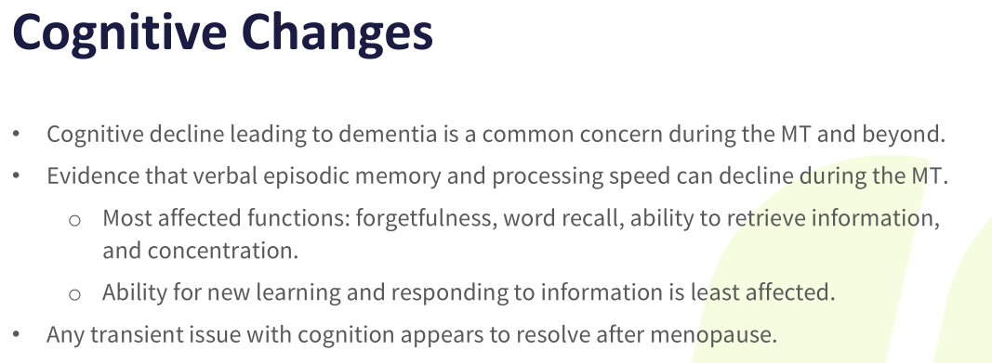
Notes:
62% OF WOMEN IN TRANSITION hot flashes and memory performance. Bilateral oophorectomy at 45 years of age or younger is associated with increased risk of dementia.
Other factors with cognitive decline and dementia: cardiovascular factors, DM, low education, obesity, physical inactivity, low social contact, excessive alcohol consumption, traumatic brain injury, and pollution.

Slide 31
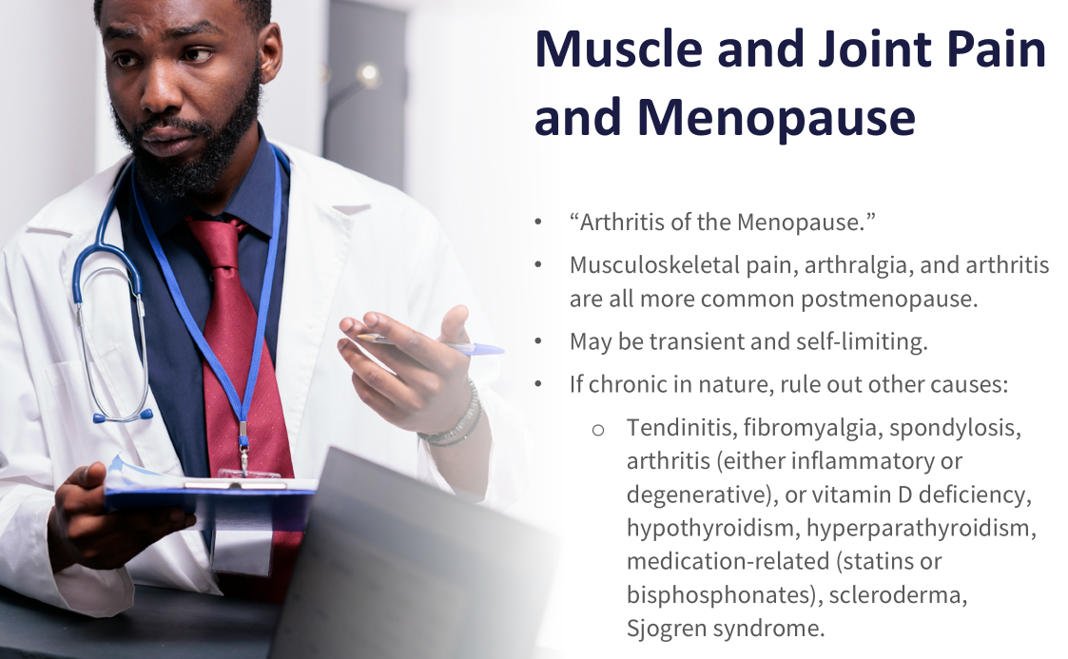
Notes:
SAW INCREASE TKA AT 55 , More than 50% of women report arthralgia, Fibromyalgia is 10 times more common Estrogen has a complex involvement in joint health:
Positive effects on cartilage metabolism.
Positive effects on balancing inflammatory reactions.

Slide 32
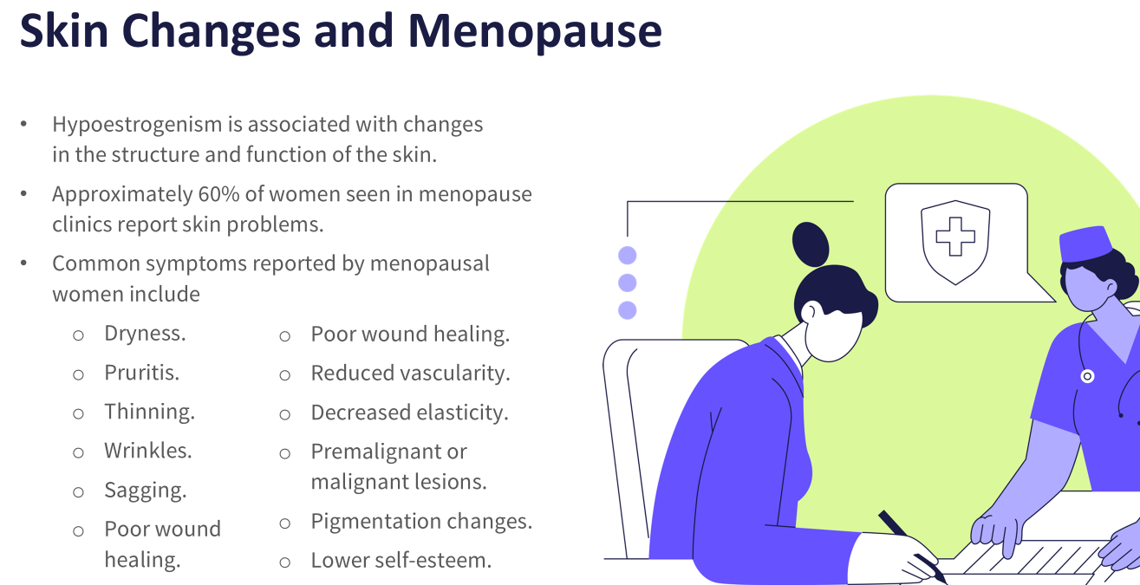
Notes:
TOPICAL ESTRADIOL ON FACE, 30% decline in skin collagen in the first 5 years after menopause, about 2% per year decline over next 20 years.

Slide 33
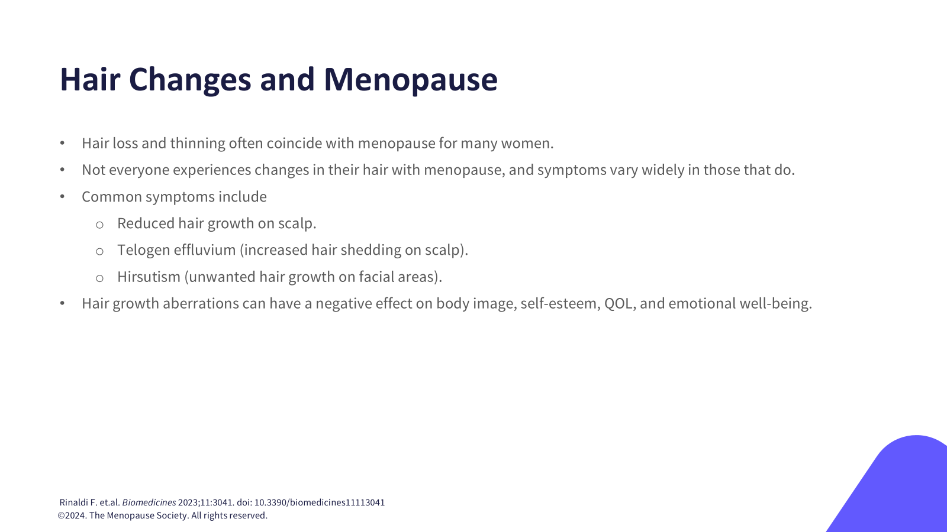
Notes:
MINOXIDIL

Slide 34
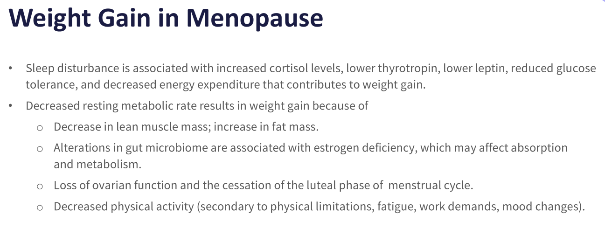
Notes:
Mayo clinic reveals 3-6 lb weight gain in perimenopause

Slide 35
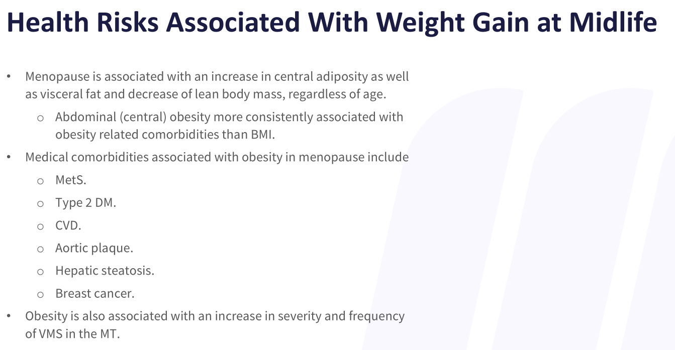

Slide 36
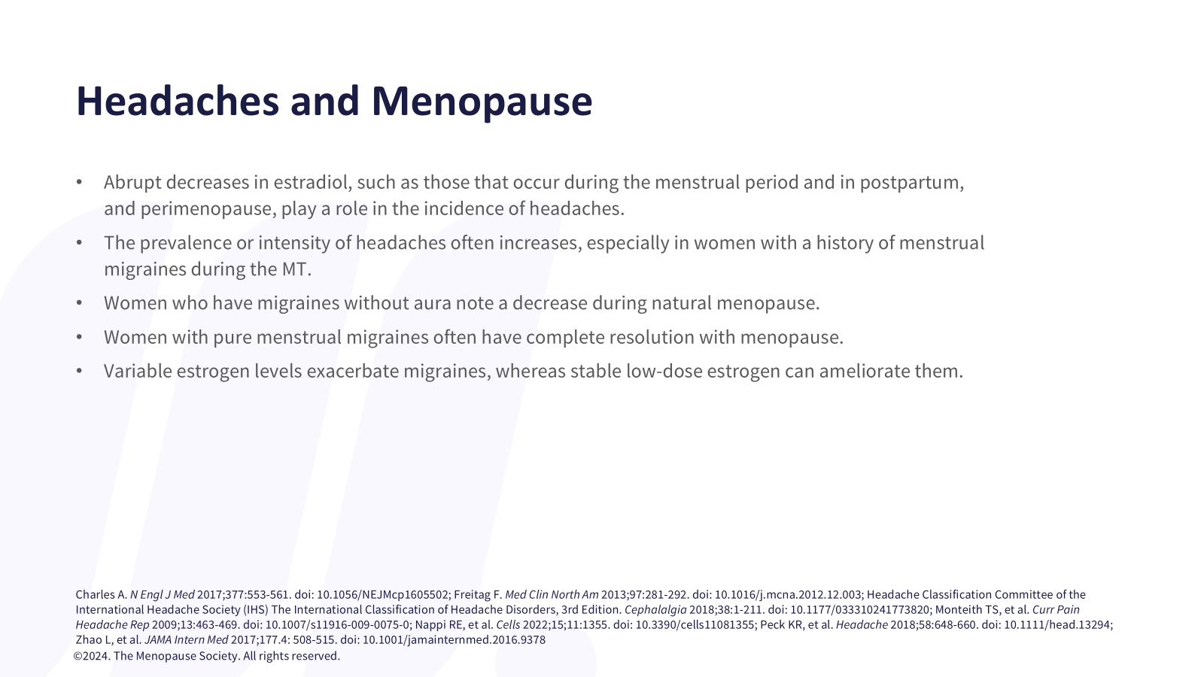

Slide 37
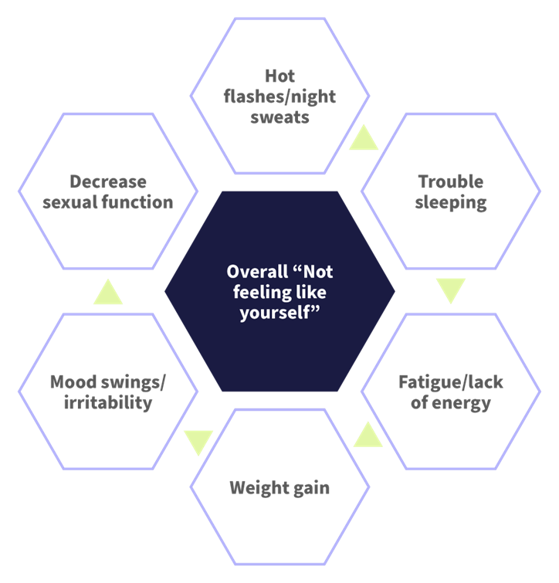
Menopause symptoms that negatively affect sexual desire

Slide 38
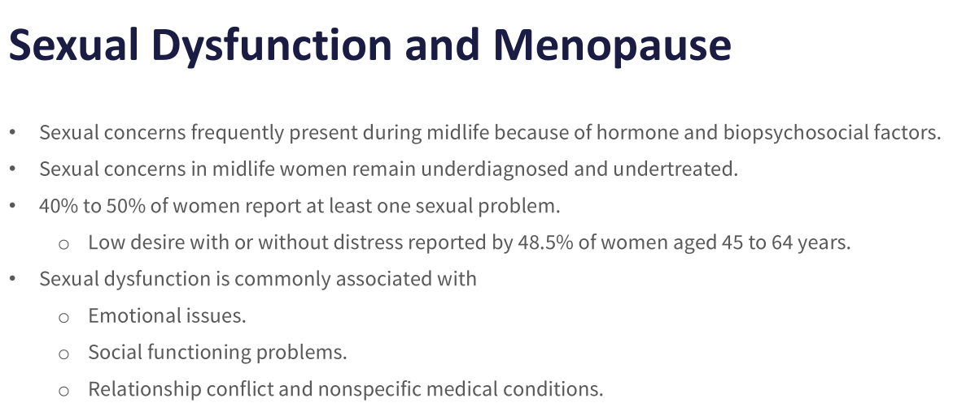
Notes:
Addi, Cialis often underreported hypoactive sexual disorder, female arousal disorder, pain/penetration disorder, testosterone, The loss of sex hormones can be associated with low libido and decrease in orgasm response. Bloodwork is constantly changing

Slide 39
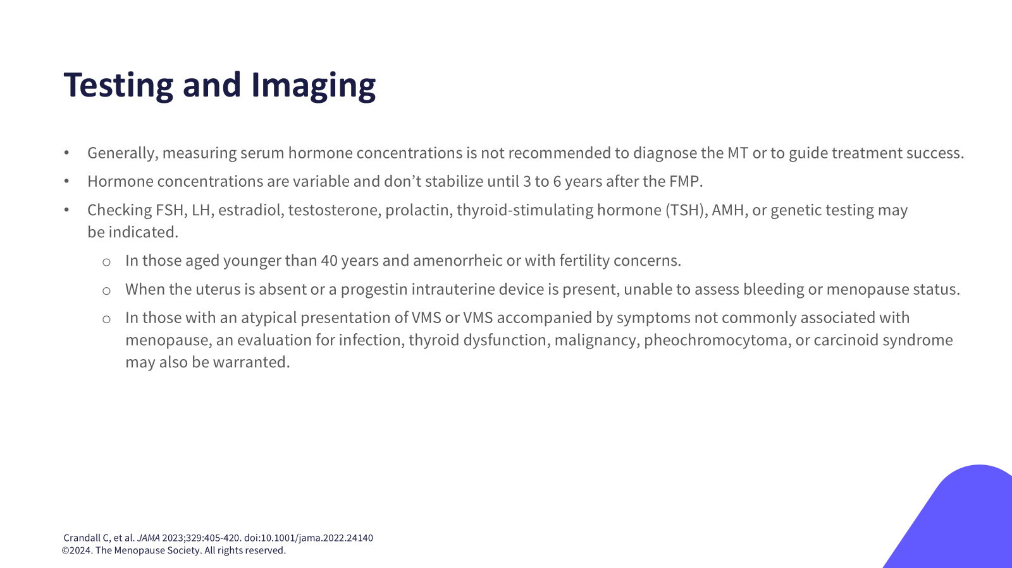

Slide 40
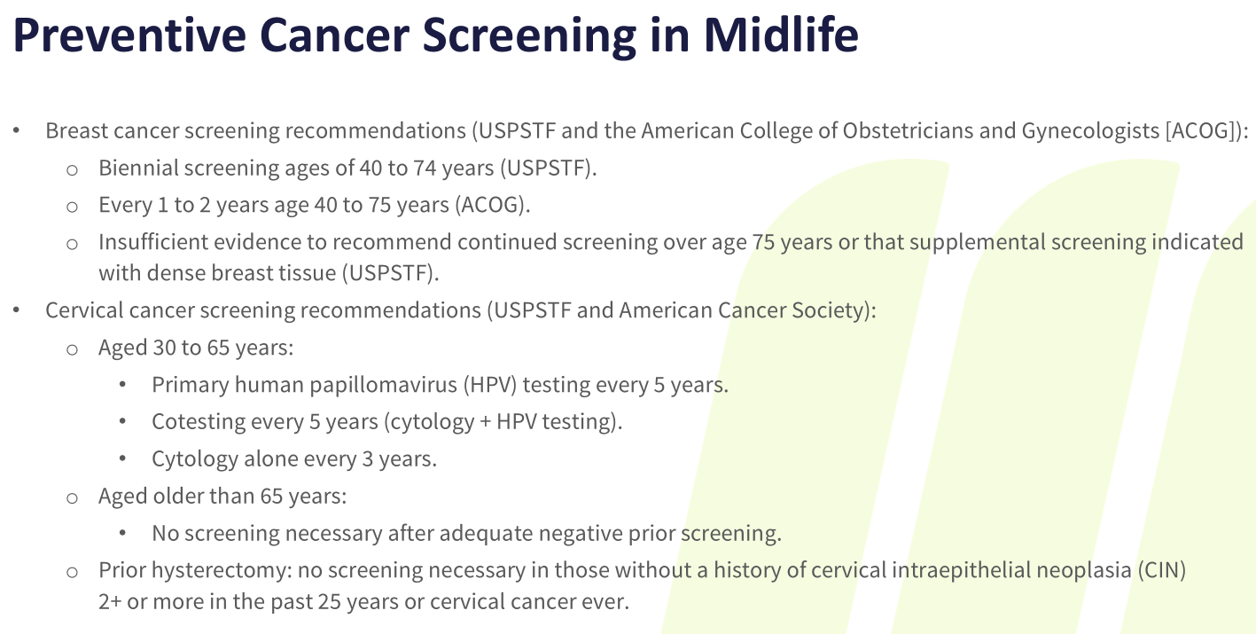

Slide 41
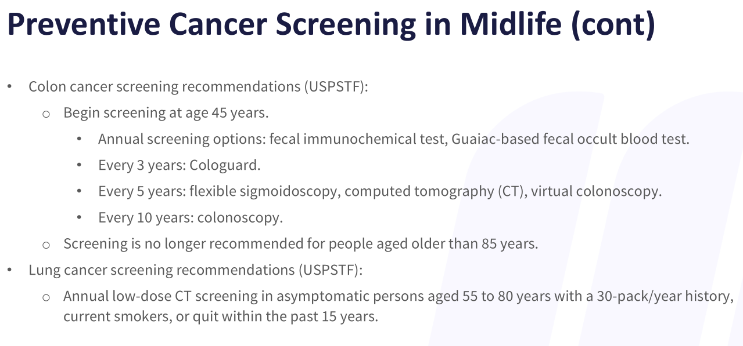

Slide 42
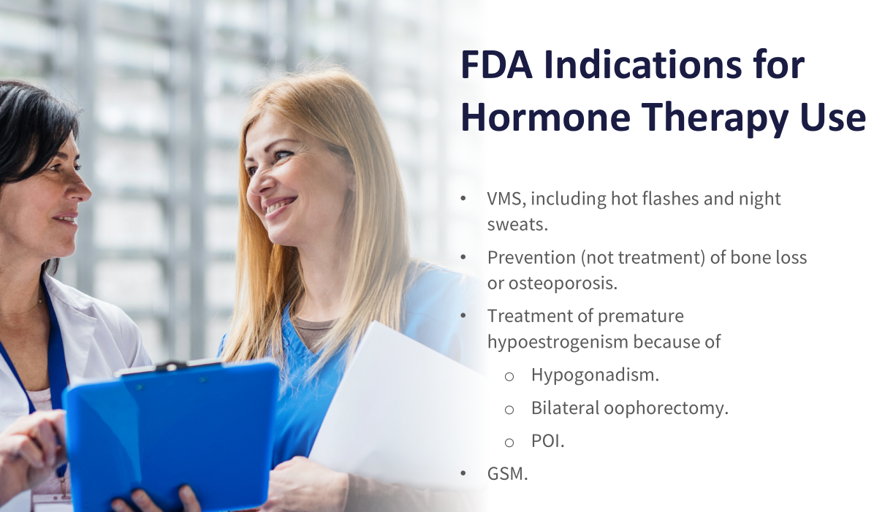

Slide 43
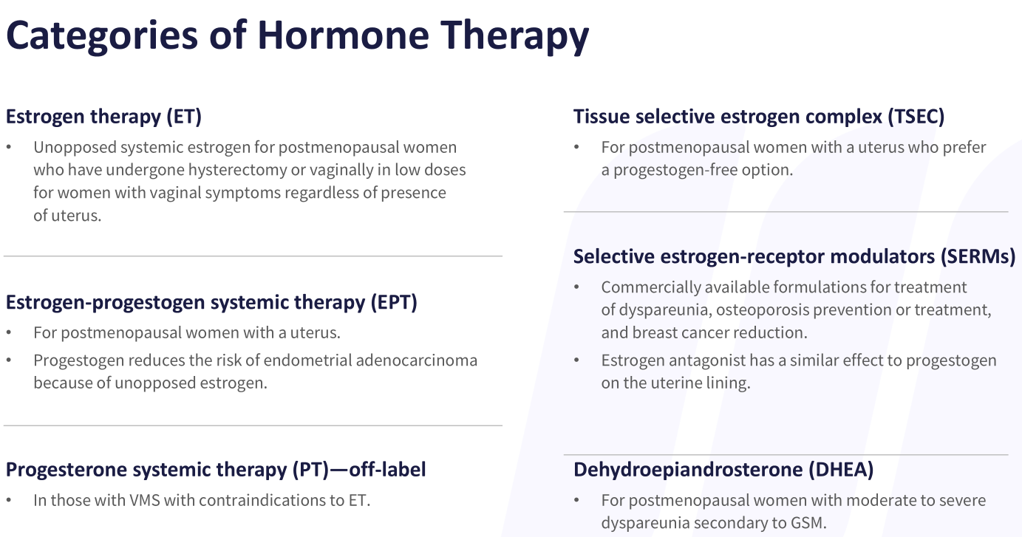

Slide 44
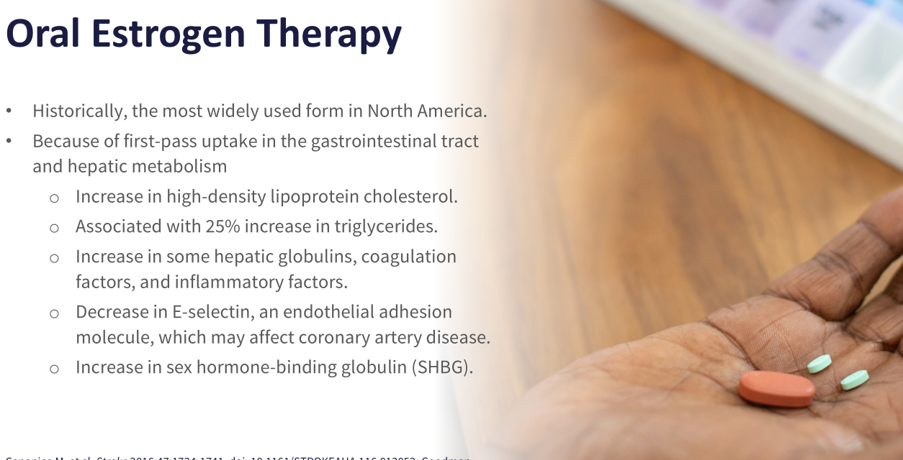

Slide 45
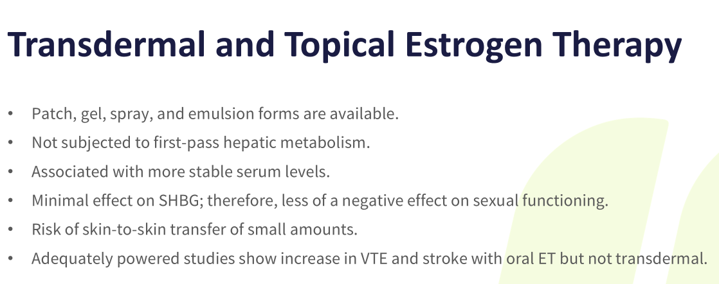

Slide 46
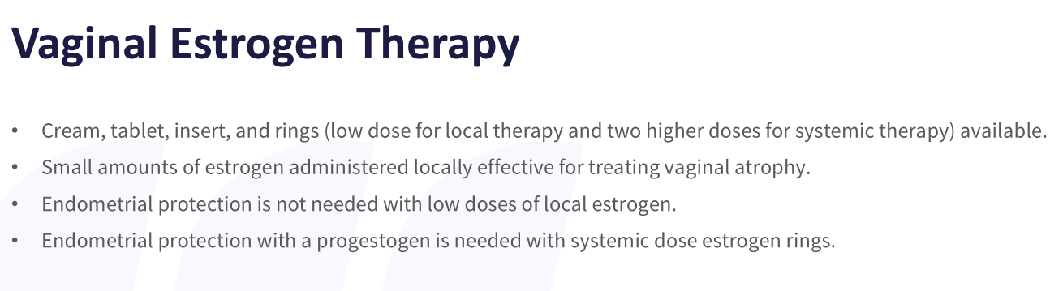

Slide 47
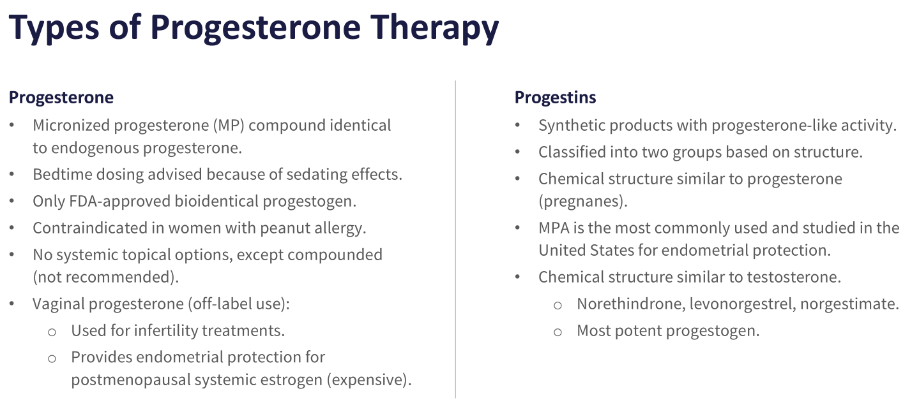
Notes:
Progestin IUD

Slide 48
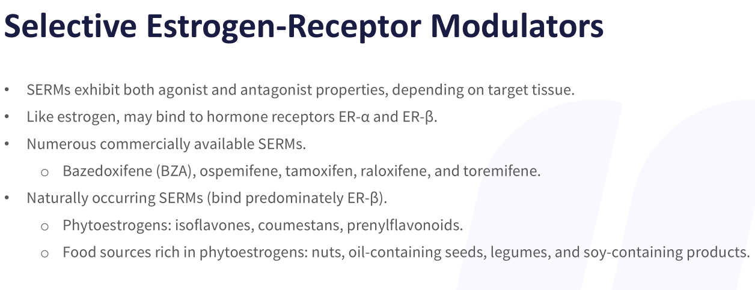
Notes:
Fda approved for osteoporosis

Slide 49
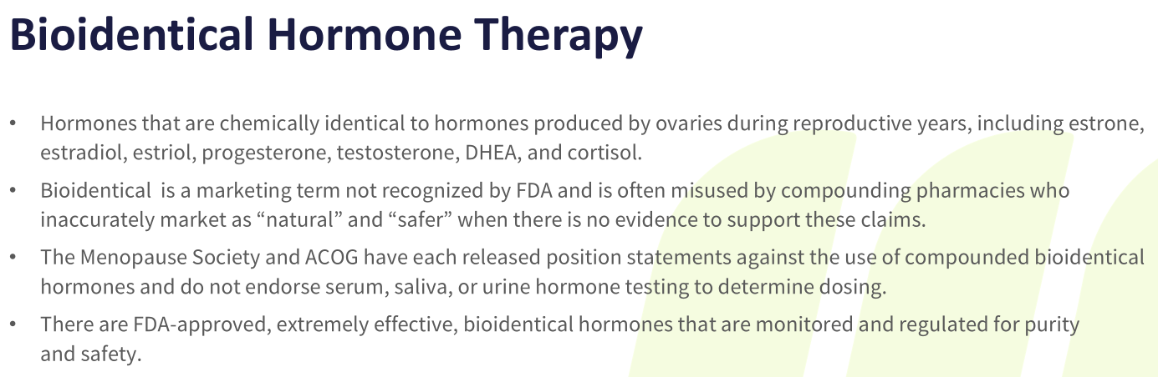

Slide 50
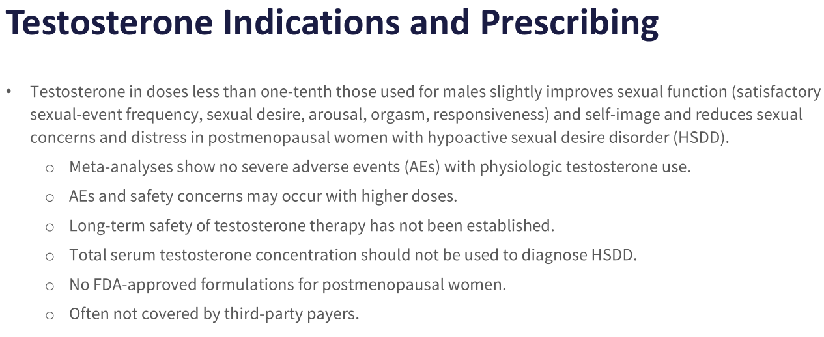

Slide 51


Slide 52
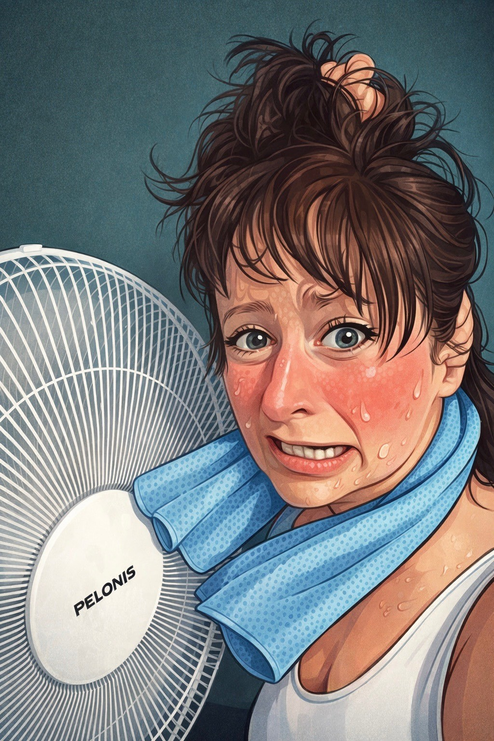
MENOPAUSE MARIE

Slide 53
Menopause Toolkit
ANTI-INFLAMMATORY APPROACH TO NUTRITION-
Fiber- 30 grams daily
Protein- 0.8 gm-1.5gm/kg daily (30 gm for breakfast)
Vit D- 2,000-4,000 IU daily
Magnesium theonate
Omega 3 daily
Creatine- 5 gm daily
EXERCISE- 150 minutes/ week
STRENGTH TRAINING- 2-3 times/week
MINDFULNESS EXERCISES/JOURNALING-Daily

Slide 54
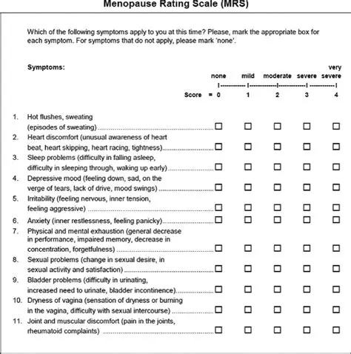

Slide 55




Slide 56
THANK YOU!!!
YOU MATTER TO US!!!
SLIDES COMPLIMENTS OF NORTH AMERICA MENOPASE SOCIETY

Slide 57
Timothy Raichle, MD
OB/GYN-Women’s Health

Slide 58
Emily Stormont, LCSW
Behavioral Health

Slide 59

Stress & Menopause
Vasomotor Symptoms
Body Changes/Body Image
Systemic Issues

Slide 60
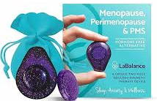
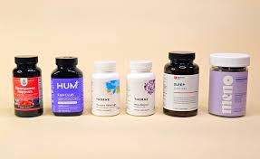


Decision Fatigue & Comparison

Slide 61

Mental Health Supports
Stressors can lead to anxiety, depression and disordered eating
Level 2 interventions
  Cognitive Behavioral Therapy
  Acceptance and Commitment therapy
  Therapy + Medication
    SSRIs, SNRIs, sleep
    Supplements

Slide 62





Level 1 Supports

Slide 63
Panel Discussion

Slide 64


Slide 65

Thank you for joining us!
We’re All In This Together

